Slide 1



Emergency ELEVATOR Power FAILURE Rescue SYSTEM
LIFT RIZZ

Slide 2

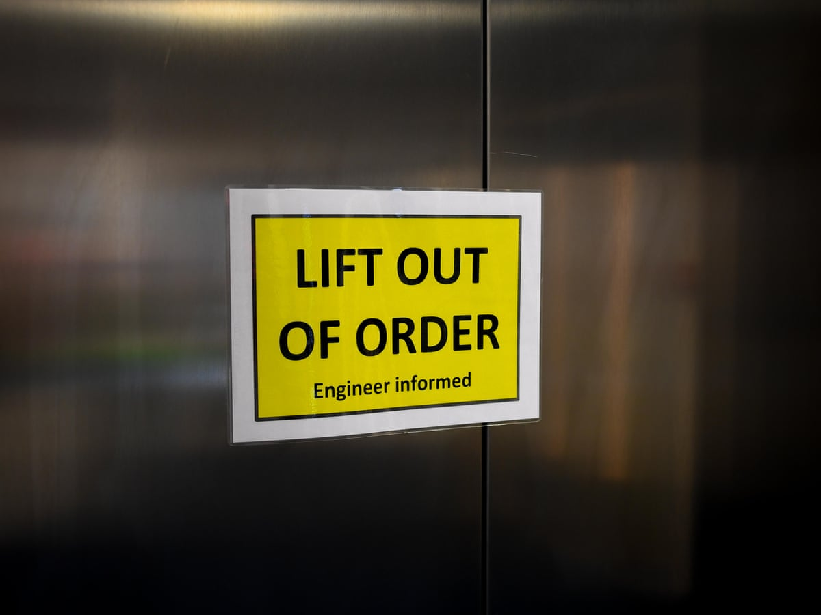
Problem statement
Modern elevator systems rely completely on continuous power supply for motor control, breaking, and door operations. During sudden power failures or voltage drops, elevators can stop abruptly between floors due to loss of drive control.
In many small and mid-scale buildings, Automatic Rescue Devices (ARD) are not installed because of high cost constraints. Backup power systems are often delayed or require manual switching. Most lifts do not have intelligent floor-position detection during outages. As a result, passengers remain trapped inside until external assistance arrives.

Slide 3
Proposed Solution
High precision Position Detection - Ultrasonic:
Ultrasonic sensors measure the distance between the cabin and reference points.
This allows accurate real-time detection of the elevator’s current position.
Real-Time Power Monitoring:
The system continuously monitors the main power supply using a voltage sensing module.
It instantly detects any sudden power interruption or voltage drop.
Automatic Backup Activation:
Upon detecting a power failure, a relay switches to battery backup automatically.
This ensures uninterrupted emergency functionality without manual control.
Safe Landing & User Alert:
The lift stops precisely at the nearest floor during power failure.
A buzzer or indicator alerts passengers about emergency rescue mode

Slide 4
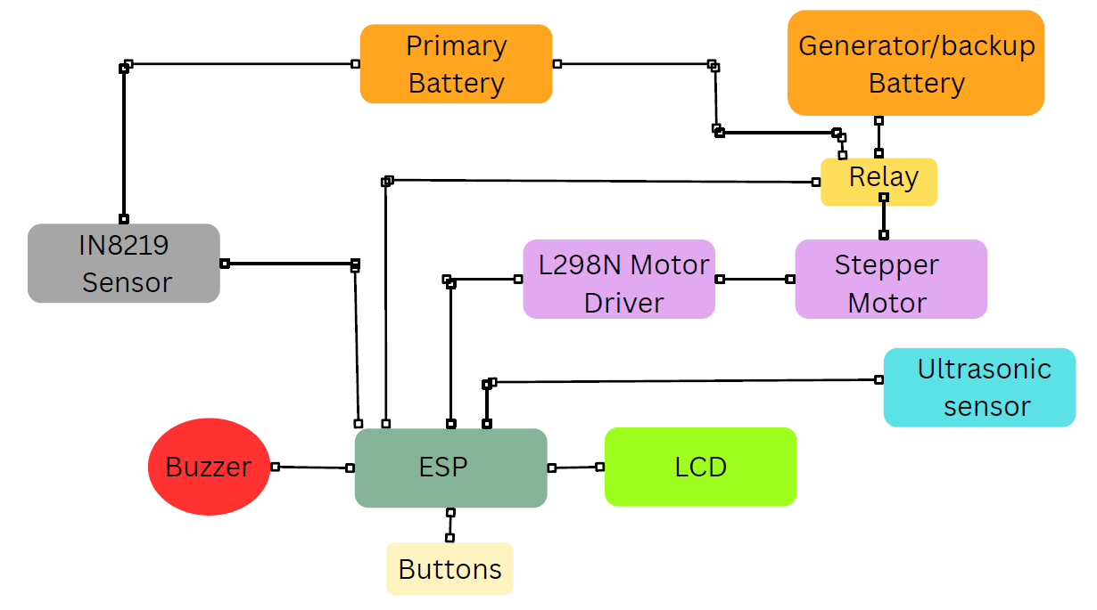
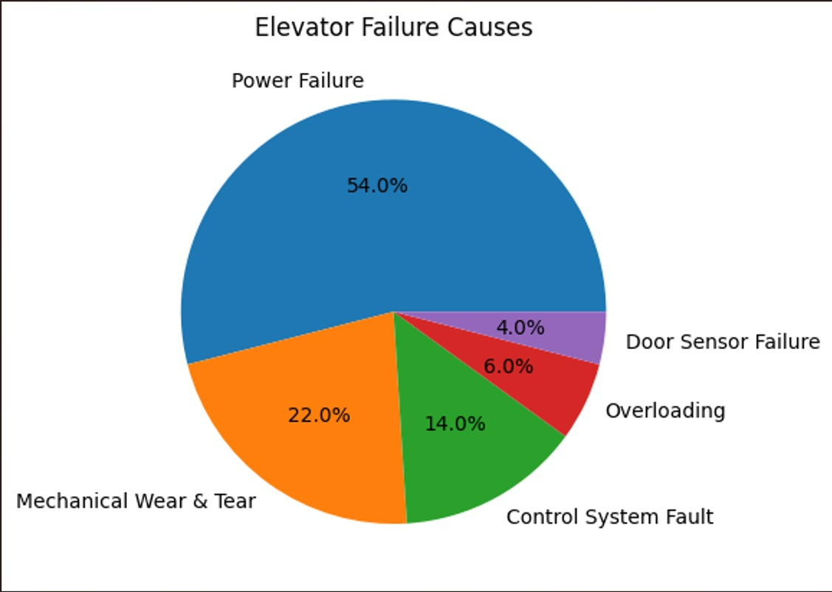

System Architecture
Major elevator failure is due to power failure
Major Causes of Elevator Failure

Slide 5
Feasibility
Retrofit: Can be integrated into existing elevator systems with minor modifications.
Low cost: The system uses low-cost and easily available components like microcontroller, ultrasonic sensors, relay, and battery.
Energy efficient: Power requirement is minimal, making small battery backup sufficient for emergency operation.
Scalability: Suitable for apartments, hospitals, and small buildings due to affordable implementation cost.

Slide 6
Existing Lift Survey
Residential Apartment Power Failure:
Sudden power cuts in apartments can cause elevators to stop abruptly between floors. In many buildings, lack of Automatic Rescue Devices increases the risk of passenger entrapment.
Backup systems often activate with delay or require manual switching. This results in residents remaining trapped for several minutes until help arrives.
Hospital Elevator Power Outage:
Unexpected power interruptions can halt elevators carrying patients or medical staff. Generator switching time may delay emergency movement within the hospital.
Even short lift downtime can affect patient transfer and emergency response. Reliable automatic rescue mechanisms are critical in healthcare environments.
Heavy Rain / Storm Power Cut Case:
Storms and heavy rainfall frequently cause voltage fluctuations and sudden lift stoppage. Buildings without voltage monitoring systems experience repeated failures.
Due to high installation costs, many small buildings avoid advanced rescue systems. Passengers remain stranded until maintenance teams intervene.

Slide 7
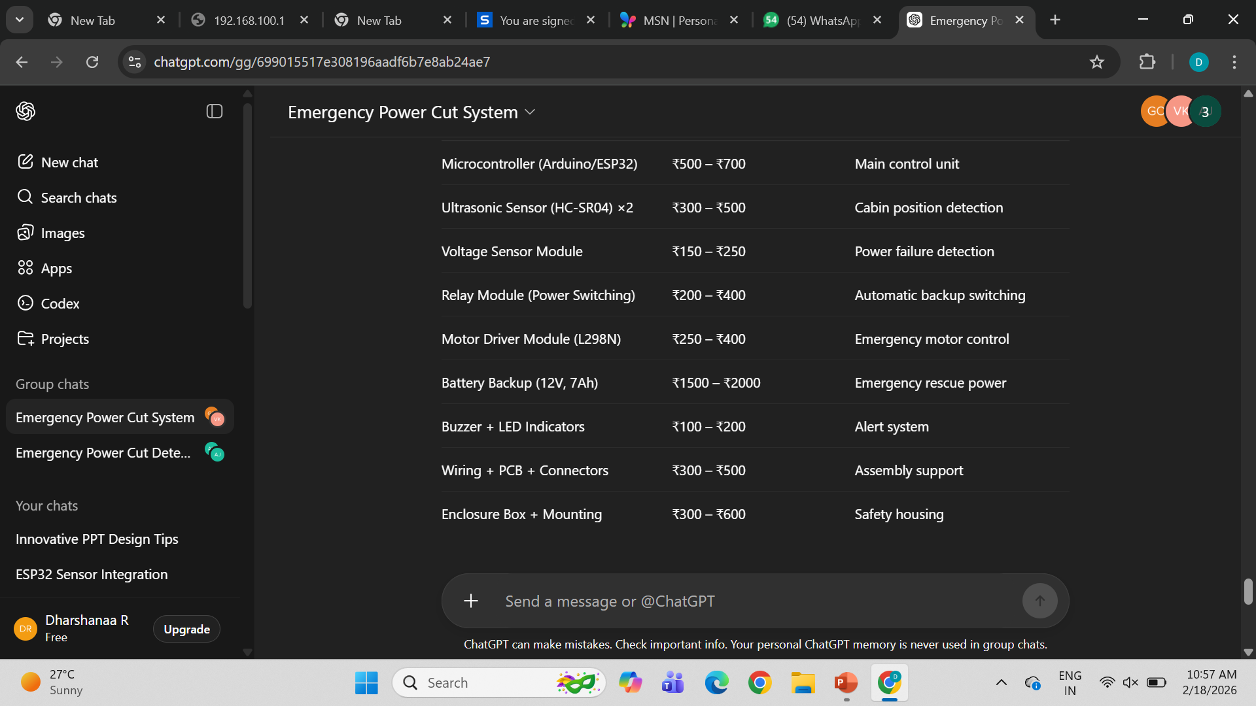
Calculations
Energy Comparison:
Existing System:
E1=P×t
=746W×2/60
E1≈25Wh
Cost Comparison:
Existing System:
60,000 /-
Energy Comparison:
Proposed System:
E2=500W×20/3600
​E2≈3Wh
Cost Comparison:
Proposed System:
5000/-
Energy Saved:
25Wh-3Wh=22Wh
Cost Saved :
60,000-5,000= 55,000

Slide 8
Innovation & Advantages,Applications & Future Enhancements
InnovationSmart automatic rescue system that works instantly during power failure.Can be integrated into existing elevator systems with minimal modification.Low-cost embedded solution suitable for small and mid-scale buildings.
Innovation:
Smart automatic rescue system that works instantly during power failure. Can be integrated into existing elevator systems with minimal modification.
Low-cost embedded solution suitable for small and mid-scale buildings.
Advantages:
Prevents passengers from being trapped between floors thus, reducing anxiety.
Ensures safe landing with smooth motor control.
Provides fast backup switching without manual technician support.
Scalable Architecture and enhances elevator reliability.
Applications:
Residential apartments and gated communities.
Hospitals and healthcare facilities.
Commercial buildings and shopping malls.
Small buildings without advanced ARD systems.
Future Enhancements:
IoT-based remote monitoring and mobile alerts.
GSM module for emergency SMS notification.
AI-based load and fault prediction system.
Integration with smart building management systems.

Slide 9


Conclusion
The proposed elevator emergency rescue system provides a reliable and cost‑effective solution for power failure situations.
The calculations demonstrate reduced energy consumption and faster response compared to existing systems. This makes the solution technically efficient and practically feasible.
From a Social point of view, passenger safety should not depend on expensive infrastructure. Our system ensures that even small apartments and hospitals can provide safe and quick emergency rescue during power cuts.
Technically, the project proves that smart embedded control and optimized power usage can significantly reduce rescue time, energy consumption, and operational cost while improving system reliability.

